Slide 1



Employee safety in a digital world
Aneta Szczykutowicz

Slide 2


The impact of technological change on the labour market
2 threads
the positive one
- assuming positive impact of technological changes on the labour market
the pessimistic one
- predicting massive replacement of human labour by digital technologies as part of the processes of automation and algorithmisation of work

Slide 3
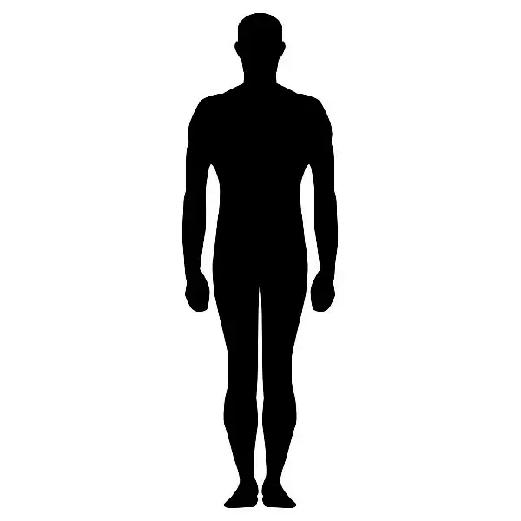
Holistic totality:
physical, mental, spiritual spheres
Creativity
Sense of empowerment
Autonomy
Sense of belonging
Sense of meaning and purpose,
links with others
. . .

Slide 4
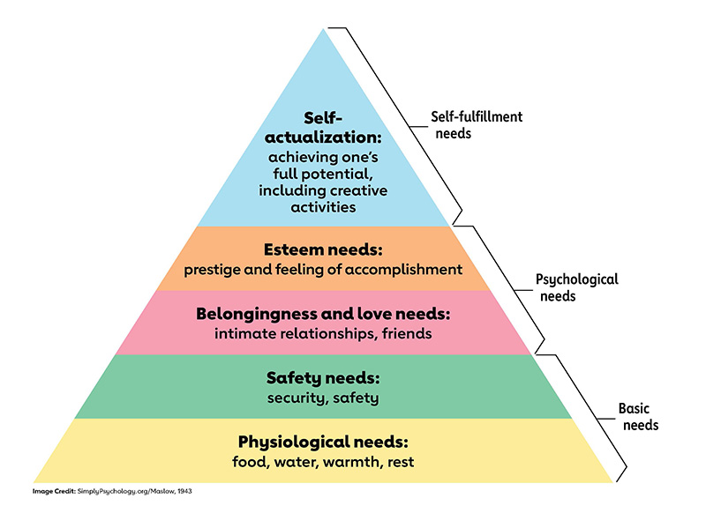
MASLOW’S HIERARCHY OF HUMAN NEEDS

Slide 5
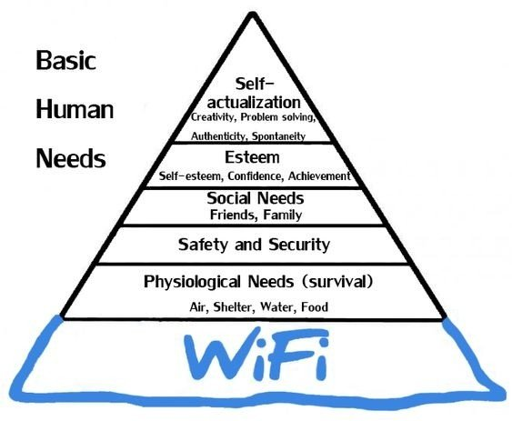

Slide 6
BODY PROBLEMS
SOUL PROBLEMS
MENTAL PROBLEMS

Slide 7
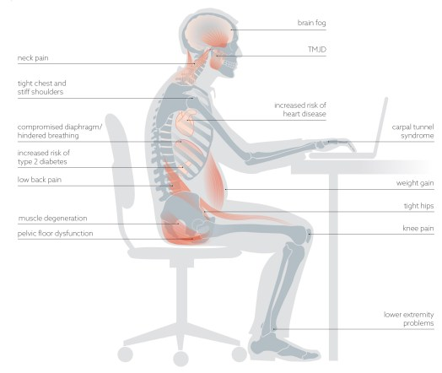
Source: Kelly Starret, Standing up to the sitting world

Slide 8
Use of electronic information and communication technologies
time pressure
multitasking
unclear breaks at work
lack of boundaries between work and private life
techno-stress, job burnout, stress, frustration and poorer health, anxiety

Slide 9

MULTITASKING
Research shows that multitasking is an illusion. The IQ of people who are distracted by incoming emails and ringing phones drops by 10 points. What are the effects of this? The same as those caused by a sleepless night. And twice as serious as those caused by smoking marijuana....*
*https://zwierciadlo.pl/; Ewa Mażul

Slide 10







The pupil (student) as a future employee

Slide 11
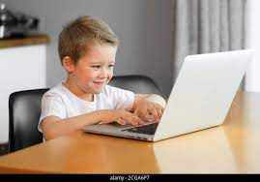

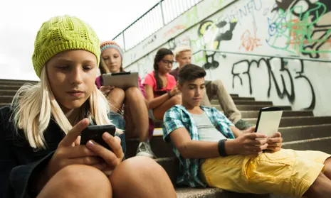


Slide 12
Percentage of students experiencing very often or often during remote education manifestations of digital hygiene*
I remained constantly available to receive calls and notifications - 63 %
I was sick of sitting at the computer/smartphone - 57 %
I felt overloaded with information - 51 %
I felt irritated because of constant use of the internet, computer or smartphone – 35 %
I used screen tools just before going to bed - 67 %
I wanted to be unavailable online to anyone – 34 %
I had a headache from the constant use of screen tools and the internet – 37 %
*Mental health and well-being of young of people during the COVID-19 pandemic - overview of the most relevant issues 2021 (J. Pyżalski).

Slide 13

I was sleep-deprived because of internet, computer, smartphone use - 34 %
I have had problems concentrating because of my use of the internet and screen tools – 34 %
I used to stay up all night using the computer, smartphone, TV, internet - 23 %
During online classes I used social networking sites, played games, browsed the Internet for private purposes, wrote to someone unrelated to classes - 28 %
I used my smartphone during e-learning to do something else - 28 %

Slide 14
According to experts*, between a quarter and half of the world's population will experience mental health problems at some point in their lives. It is estimated that by 2030, the cost of dealing with mental illness worldwide will be more than $6 trillion a year.
FUTURE OF WORKERS’ MENTAL HEALTH PROTECTION
– BIG challenge!
* Deloitte report, www.brief.pl (13.01.2022)

Slide 15
Pros and cons of digitalization according to psychologist - Julia Scharnhorst*:
PROS:
+ saving time and money on commuting
+ possibility of reconciling family roles
+ good, favourable conditions for concentration and time management
*https://www.deutschland.de/pl/topic/gospodarka/swiaty-pracy-przyszlosci-wady-i-zalety

Slide 16
CONS:
- the home office can also foster a „lone wolf mentality”
- digitisation will affect every type of workplace. It is to be expected that the mental workload will increase, because more concentration and attention will be required
- there is also the danger of being overloaded due to workstation congestion and too much information. Digitalisation often goes hand in hand with a reduction in autonomy, as the computer has already made all the decisions and the human only has to implement them
- Excessive and increasingly developed control of working time and productivity increases the pressure on employees (e.g. measuring time spent on breaks, in the toilet - dehumanizing people management !

Slide 17
RECOMMENDATIONS:
A certain amount of freedom within the division of tasks and the choice of time and place of work has a positive effect on mental health. Overly rigid guidelines and ossified structures cause more stress and mental disorders.
At the same time, companies must ensure that employees who often work from home are sufficiently integrated. This is why it is so important that those who work remotely also experience recognition and respect.

Slide 18
SUGGESTIONS AND PROPOSALS OF SOME GENERAL SOLUTIONS:
permament coopeartion with psychologists
1. ADVISORY FUNCTION to:
Staff
Management
2. PREVENTION
3. DIAGNOSIS
4. HELP

Slide 19
forums, platforms, applications - employers and employess
exchange of good practises, eduaction

Slide 20
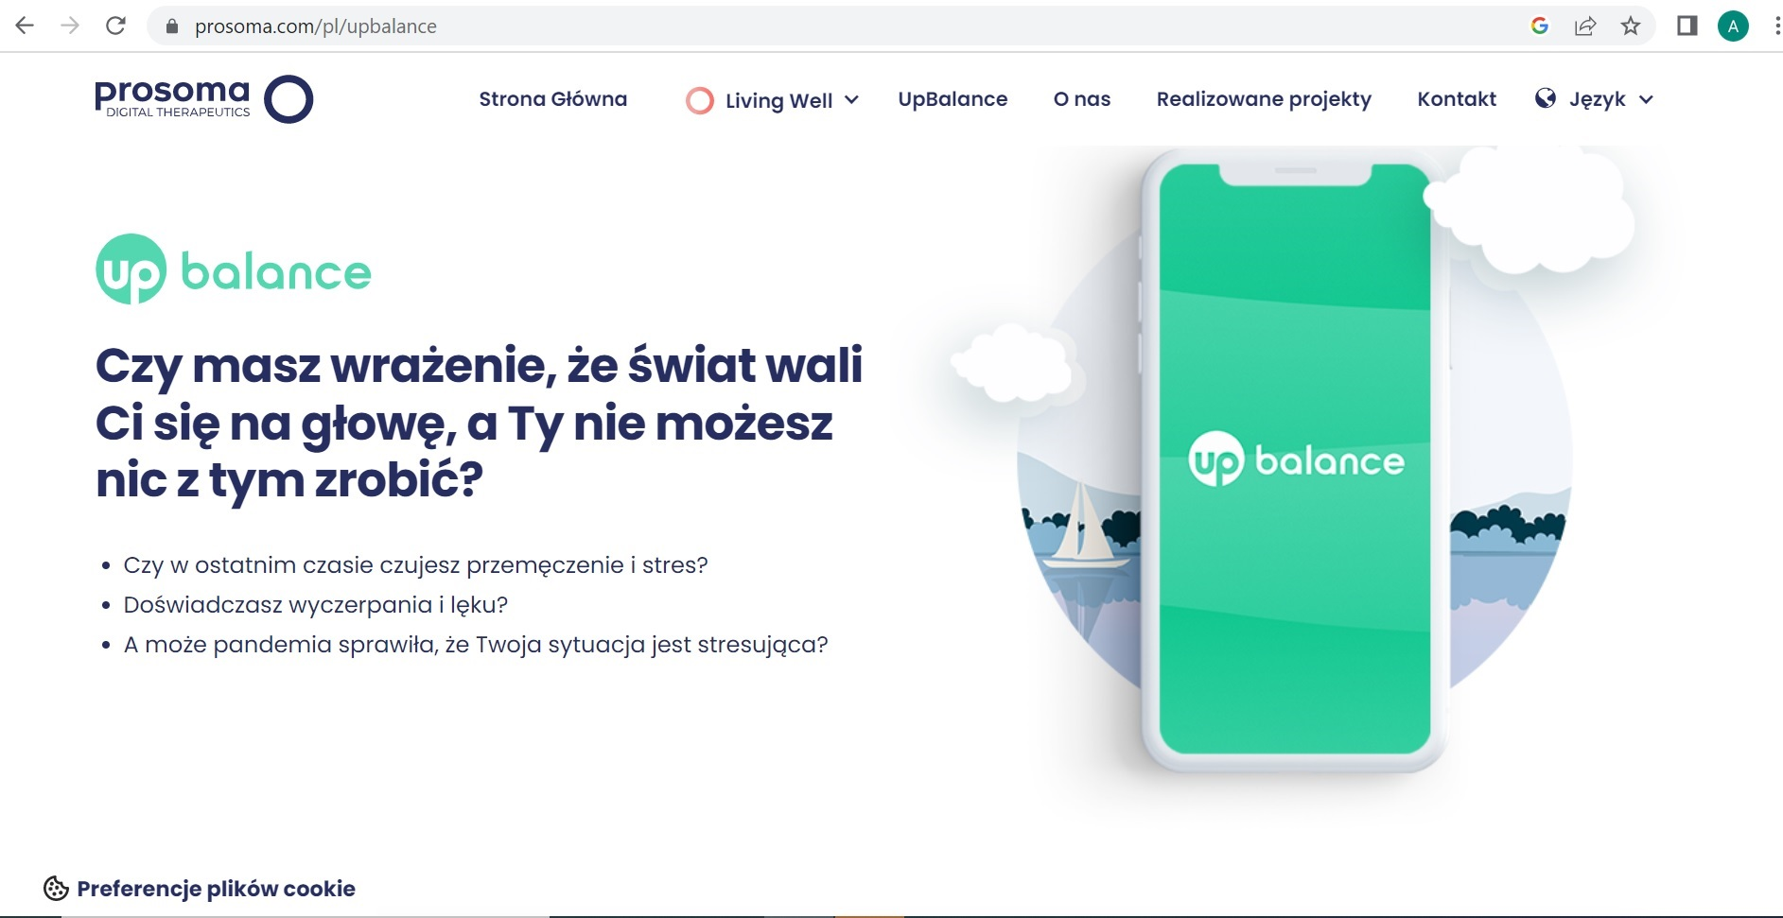

Slide 21
CHANGE IN ATTITIUDE
There is a growing awareness among employers of the role they should play in supporting the mental health of their employees.
When caring for the general wellbeing of employees, companies most often demonstrate a holistic approach. Implemented well-being programmes usually include solutions to develop universal soft skills (e.g. the ability to manage stress), as well as encouraging employees to lead healthy lifestyles and undertake activities that can help them find their way in the new reality (e.g. exercise).
In addition, psychological tele-councelling , comprehensive health assessments, group support programmes, webinars with health experts and online courses related to mindfulness are increasingly on offer to employees.
https://www.hays.pl/

Slide 22

THE RIGHT TO BE OFFLINE
TAKING CARE OF EACH OTHER :
- employer for employee
- the employee for himself
- employee for employee
- the employee for the employer

Slide 23

SELF – CARE
Setting boundaries for yourself and others
Skillful time management
Prioritization of tasks - Avoiding mental involvement in several activities at once
Taking short breaks at work for movement, taking care of movement after work
Virtual self-discipline at home

Slide 24
Actions to be taken:
Psychoeducation
Digital education and adequate training for upskilling
Protection of workers remaining in non-standard forms of employment - platform workers

Slide 25
The Deloitte Report
64% of the surveyed employees declare that they would agree to a lower salary if it would be possible to make the time and place of work significantly more flexible,
the willingness of employees to change the place of work decreases by 87%.
The digitalisation of work brings positive results for both sides of the employment relationship.

Slide 26

New regulation of the Minister of Labor in Poland – 7.04.2023
Introducing the definition of remote working
Remote work will consist of performing work
completely or partially at a location designated
by the employee (including the employee's home address)
and agreed upon with the employer in each case.
The law provides for both total remote work and hybrid remote work (partly at home, partly at the company), according to the needs of the specific employee and employer.

Slide 27
Agreement of remote work between employee and employer
Remote work will be able to be agreed upon:
at the conclusion of the employment contract
or during employment (in the form of an amendment to the terms of the employment contract; no written form will be required)

Slide 28
The employer will, as a general rule, have to grant a request for remote work made by:
a pregnant employee,
an employee raising a child up to the age of 4
an employee caring for another member of the immediate family or another person in a common household with a disability certificate or a certificate of significant disability

Slide 29
Allowing remote work at the request of the employee also in the case that there is no agreement or regulations, specifying the rules of remote work
In case that the employer does not have an agreement or regulations for remote work - it will be able to be applied at the request of the employee concerned

Slide 30
Remote occasional work:
remote occasional work will be granted at the request of the employee (non-binding, the employer will be able to refuse to consider it)
to the extent of 24 days per calendar year
due to its special nature, some provisions on remote work (e.g., the obligation to provide work materials and tools) will not apply

Slide 31
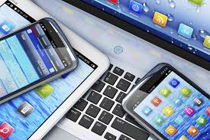
The employer will be required to:
Provide the remote worker with work materials and tools, including technical equipment, necessary for remote work

Slide 32

Before allowing remote work, the employer will be obliged to prepare an occupational risk assessment (the employer will be able to prepare a universal occupational risk assessment for each group of remote work positions)
and, on its basis, to prepare information containing the principles of safe remote work and familiarize the employee with it.

Slide 33
Such information should include:
principles and ways of proper organization of the remote workstation
principles of safe and hygienic performance of remote work
activities to be performed after the completion of remote work
principles to be followed in emergency situations that pose a threat to human life or health

Slide 34

THANK YOU !
Aneta Szczykutowicz
E-mail: a.szczykutowicz@eds-fundacja.pl

