Slide 1

COV and the digitization
How to deal with it in education and in the organization of the union?
NKOS
09-06-2023

Slide 2
Table of contents
Part one: digitization in education
  Flemish digitization before COVID-19
  After COVID-19 crisis
  How COV looks at long-term digitization
Part two: Digitization in our own organization
  How we work in COV as a professional organization
  How we use it as a member organization
    Social media
    Other digital tools

Slide 3
Part ONE:
Digitization in education

Slide 4
Flemish digitization before COVID-19

Slide 5
Cornerstones
Education has a key role in society
Education is a public good
Freedom of education as an essential principle to achieve quality
Teachers are autonomous professionals

Slide 6
ICT-requirements in Flemish education
ICT is included in cross-curricular attainment targets
Students need to be able to:
Have a positive attitude toward ICT
Have the ability to use ICT in a safe, responsible and effective way
Have the ability to use ICT to creatively shape their own ideas
Use ICT to retrieve, process and store digital information intended for them
Have the ability to use ICT in presenting information to others
Minimum goals

Slide 7
MICTIVO - research
Every 5 years
Study that monitors educational ICT indicators
Infrastructure, policy, usage, competencies and perceptions
Teachers, students, school board members
Results of 2018
Elementary education:
57% of desktops and laptops were older than 4 years old
33% between 1 and 4 years old
65% of principals had an ICT policy plan
Primary teachers average used ICT “several times a month” to “weekly” to prepare lessons and during class.

Slide 8
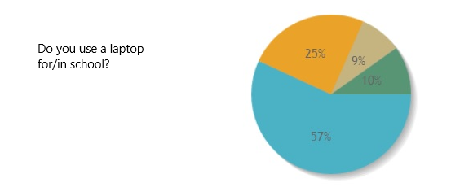
COV survey 2017
10% of members said not to use a laptop for school work
57% declared to have bought their own laptop to use for school
9% could use a computer from school, but not allowed to take home
25% received a laptop from school that they were allowed to take home

Slide 9
Other surveys
PISA survey 2018
Integration digital resources
63rd of 78 countries
TALIS survey 2018
Confidence skills ICT materials
23,7% teachers felt competent
EU5 – 31,7%

Slide 10
Professionalization
65 euro per full time staff member per year for all domains in professionalization.
Far below the price of in-service training in Flanders

Slide 11
After COVID-19 crisis

Slide 12
Beginning of the pandemic
Very difficult for schools to provide good distance education
COV survey:
  more than 50% purchased ICT tools themselves to improve distance learning
  51% used their own laptops for school work
Did you invest personally in ICT-materials?

Slide 13
DIGISPRONG or DIGI-JUMP
Based on Europe’s relaunch funds
Digisprong:
400 million euros
device for every student and teacher from the 5th year of primary school.
A device per classroom for the earlier years in primary and pre-primary school
Infrastructural work
More teacher professionalization → per FT 120 euros for ICT skills
Bootcamps for teachers
Knowledge and advice center ‘digisprong’

Slide 14
Role of COV during negotiations
Expanded the budget so device for all teachers
Internet allowance
Agreement framework on the use of digital tools

Slide 15
In Conclusion
ICT has become an integral part of daily classroom practice
Digital tools have an important influence
The way of working
The organization of schools and work in schools

Slide 16
COV on long-term digitization

Slide 17
A need for long-term vision
Long-time investments
Long-time vision

Slide 18
The teacher is central
Digitization as a means to support the educational process
Technology should never replace a teacher
Respect the teacher and his autonomous professionalism
Digital technology is a tool, not a goal.

Slide 19
ICT policy tailored to the school
Digital technology as a means to achieve better education for all
Freedom for school teams to choose the ICT policy that fits their pedagogical vision

Slide 20
Awareness of the opportunities and risks
Commercialization
Data as an interesting outcome for EDTech companies
Teachers must not become subject to economic interests
Privatization
Digital platforms and learning tools
Need for clear guidelines and government control

Slide 21


Awareness of the opportunities and risks
Data ownership and privacy
  Who owns the data?
  Data = power
Preventing inequality
  Risk widening differences in socioeconomic background
  Flanking policy initiatives

Slide 22


Awareness of the opportunities and risks
Teacher as professional user
  More than ‘having digital competencies’
  Digital literacy and critical thinking
  Need for plan based on vision in school for digital technology within pedagogical project.
Wellbeing and digitization
  Key focus – establishing the deconnection framework
  Monitoring use and impact of ICT

Slide 23

Code of ethics
Demand for Regulatory framework
Involving all educational actors
Level playing field

Slide 24





Code of ethics - COV
Equitable and democratic
Privacy
Transparancy and security
Accountability and adaptability
Sustainability and reliability

Slide 25
Part Two: the use of digital tools and online communication in our organization

Slide 26


1. Digitization in our daily work
Goal:
  Efficient meetings
  Sharing knowledge
  Better collaboration

Slide 27
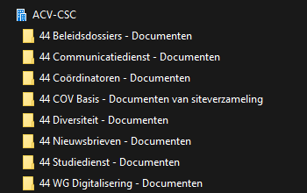
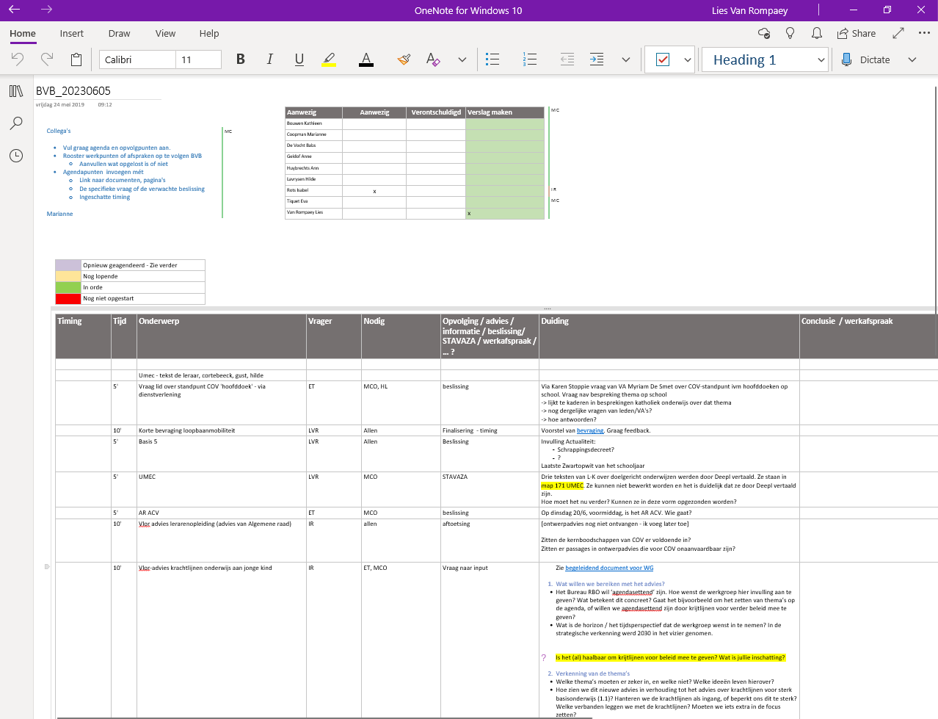
Sharepoint and One Note

Slide 28
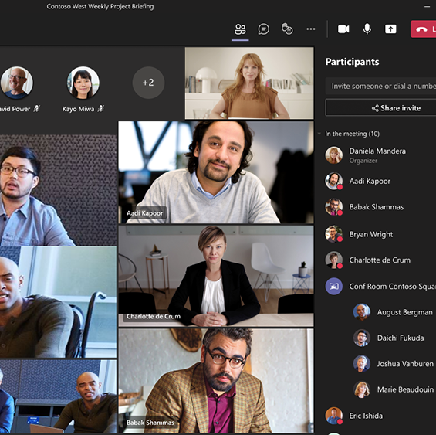
Digital meetings
Here to stay
Not in favor of hybrid meetings in our organisation
Brainstorm or debate: better in person
Keeping up with innovations and possibilities

Slide 29

2. Digitization in our communication and services
Social media
Website
Newsletters
Whatsapp?
Training – webinars
Services

Slide 30
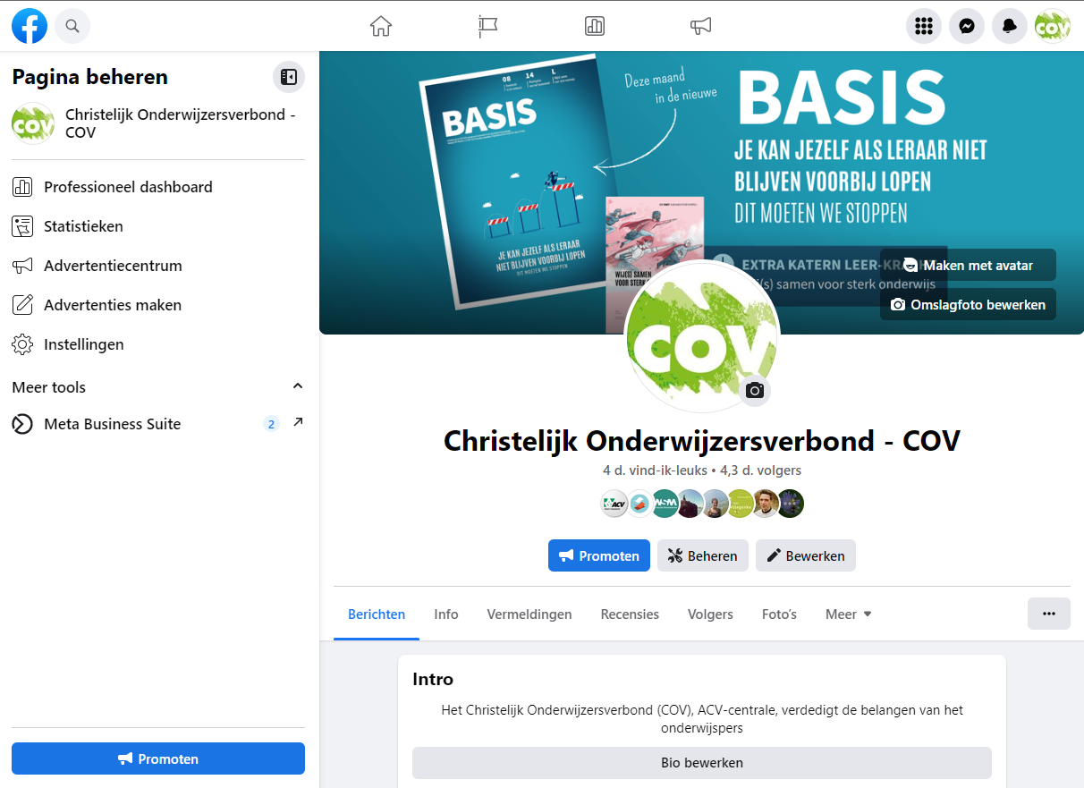
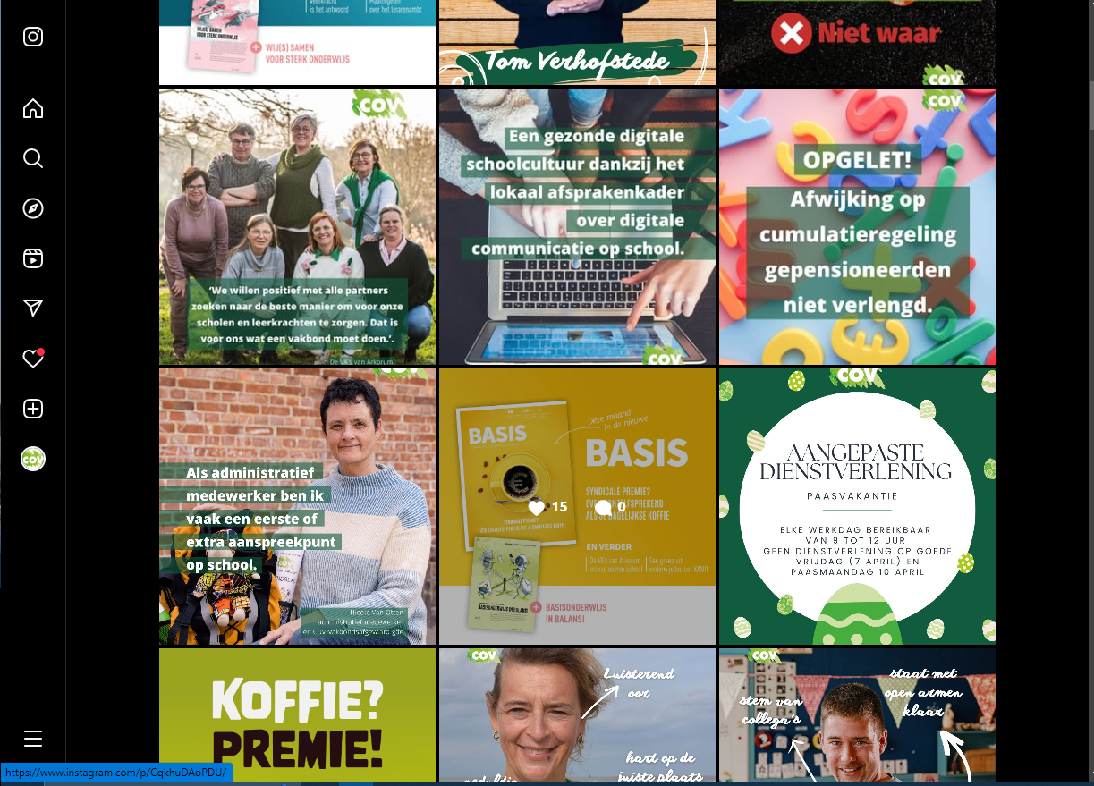
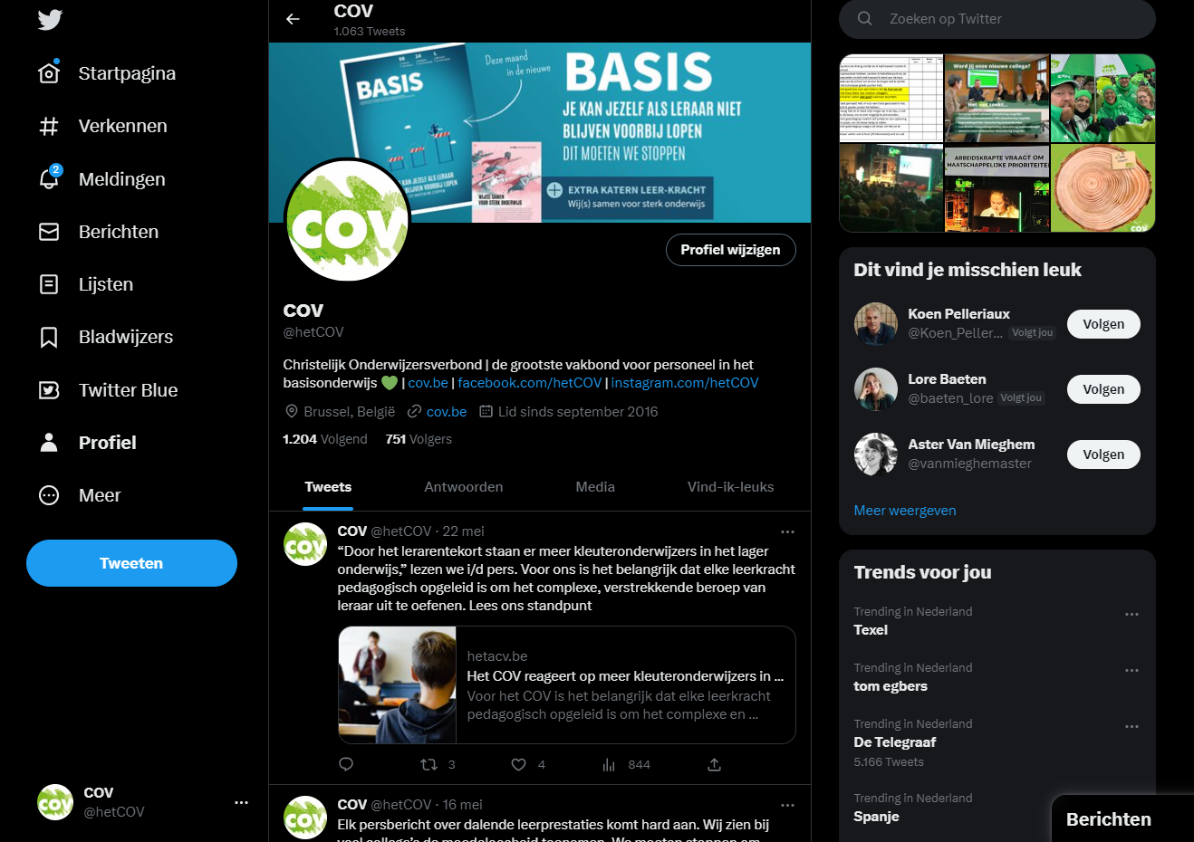
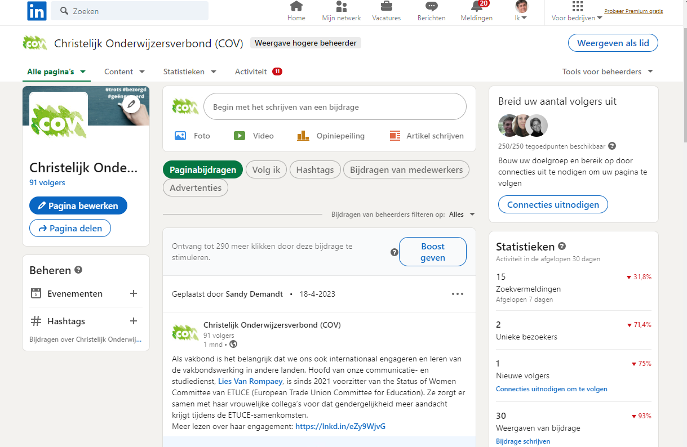

Social media
Facebook
Instagram
Twitter
LinkedIn
Social Media

Slide 31

Facebook
Why:
Connect with our members
How:
Short strong messages
Results:
4305 followers
Make COV visible
Inform
With image
Call to action
Limited number of likes
Reach of the post is often higher
Engaging posts

Slide 32


Instagram
Why:
Make COV visible
Build the immage of a warm engaged organization
How:
Engaging versus light-hearted posts
COV behind the scenes
Quality images
Use the stories!
Actions to increase the number of followers
Results:
1102 followers
Limited number of likes
Reach: 40% of the followers

Slide 33

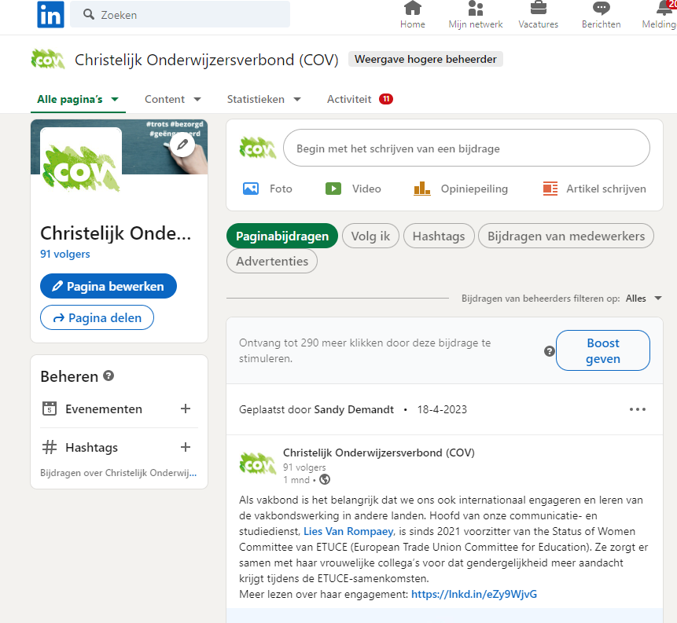
LinkedIn
Why:
Build the image of an expert organiszation, also on the pedagogical field
Build a network of education experts, policy makers, civil society
How:
Post articles from member magazine
Higlight participation in expert panels
Results:
91 followers
Need to activate our visibility

Slide 34

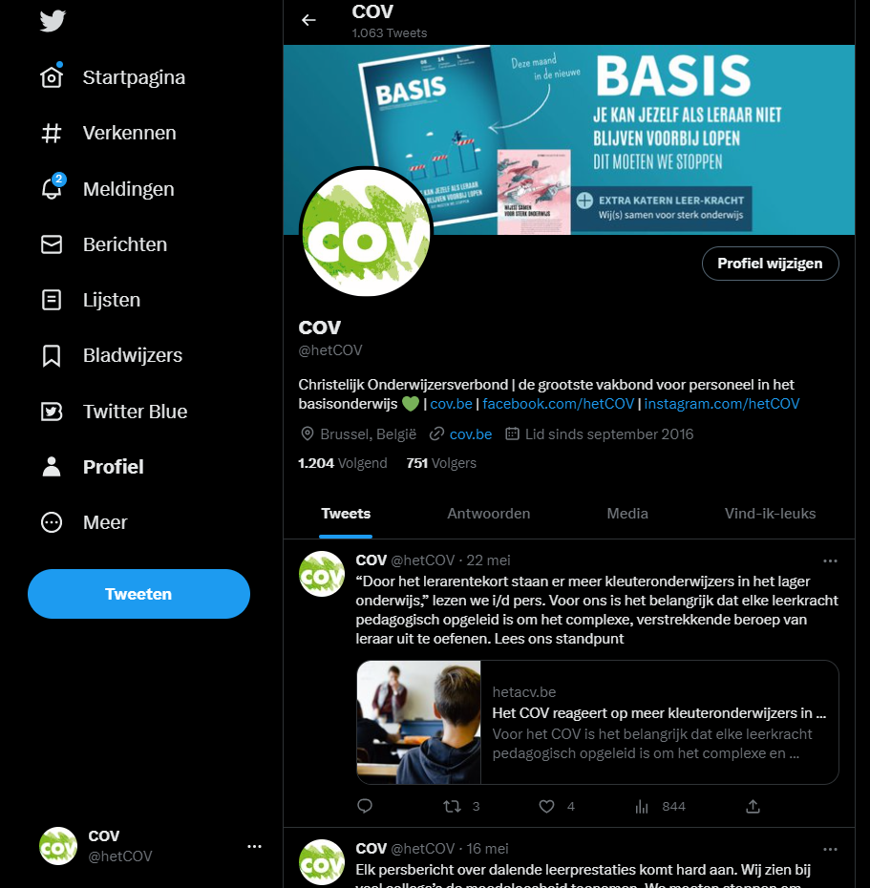
Twitter
Why:
Reach a wider audience of press and other organisations
Make ourselves known as THE experts on primary and preprimary education
How:
Post our policy positions
Links to our website
Support befriended organisations
No discussions
Results:
751 followers
Wider reach than the likes suggest

Slide 35
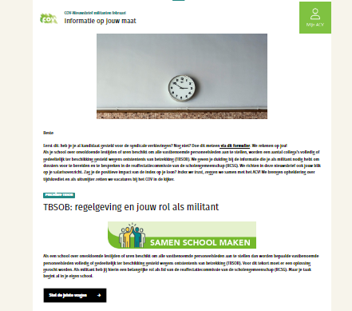
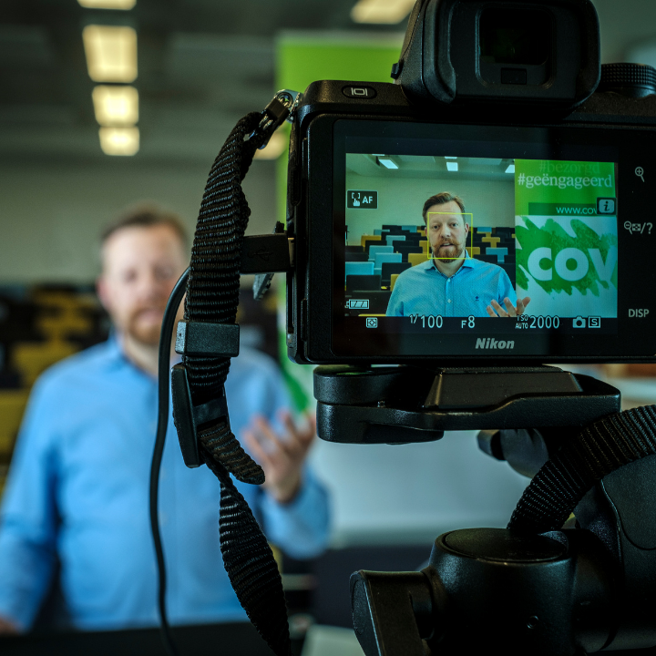
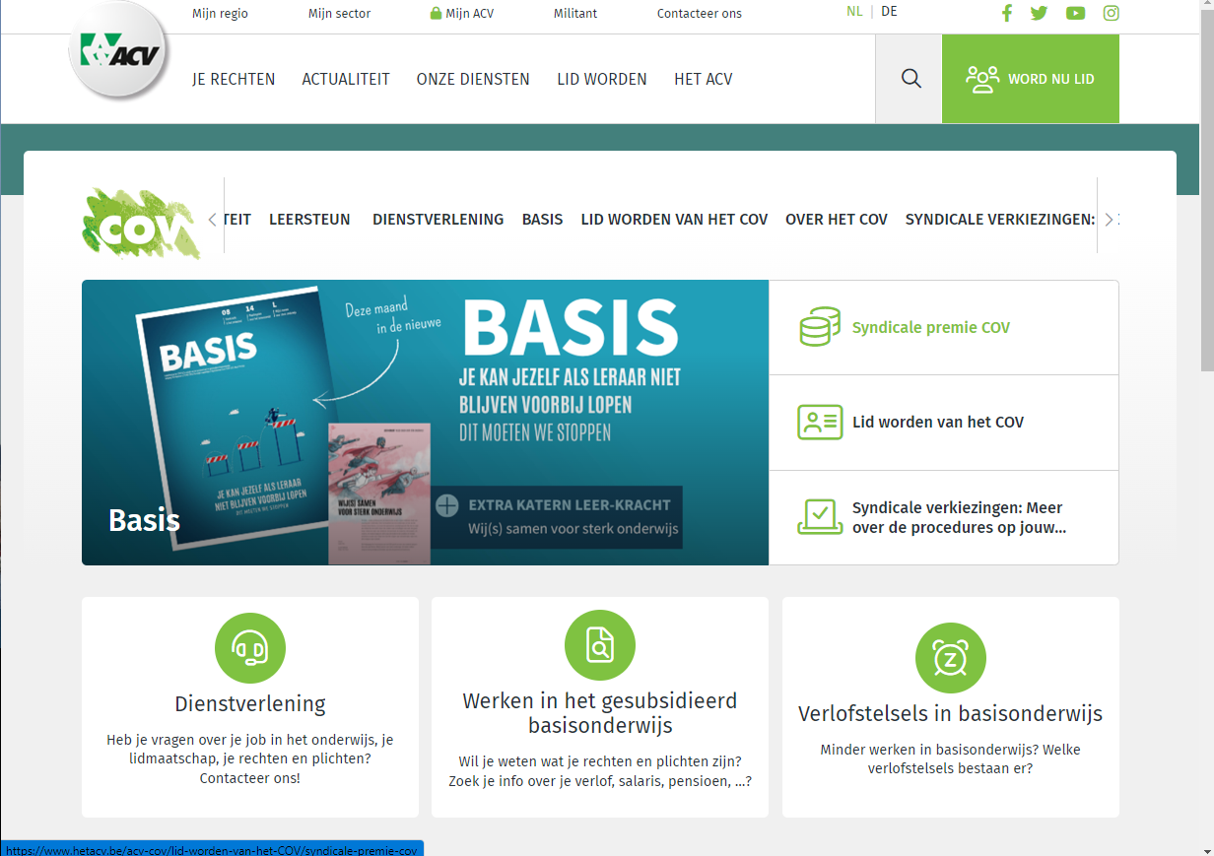

Other digital tools
COV-website
Newsletters
Webinars
Digital services
Other digital tools

Slide 36

COV-website
Integrated in the website of our confederation ACV-CSC
www.cov.be

Slide 37
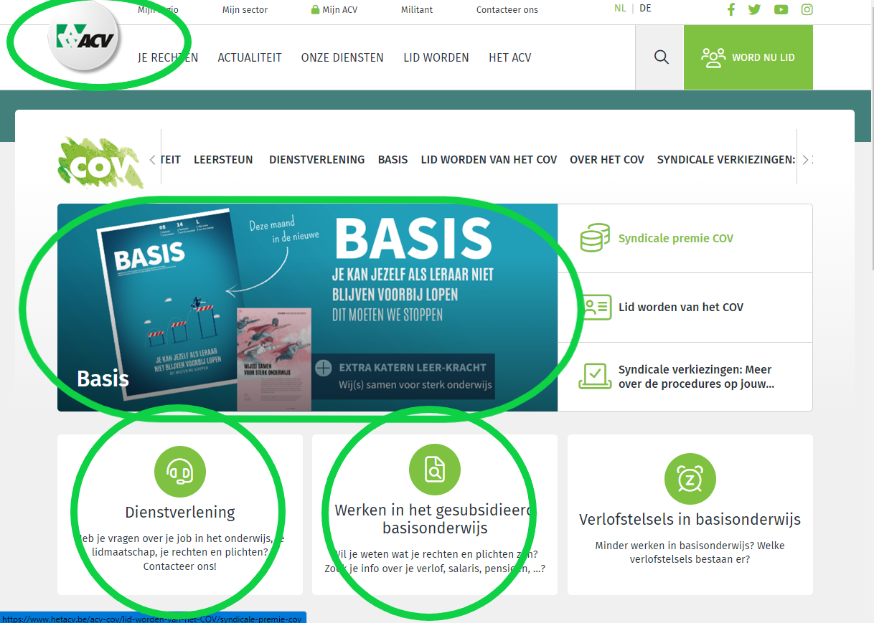
COV-website
Draw attention to
Member magazine
Member services

Slide 38
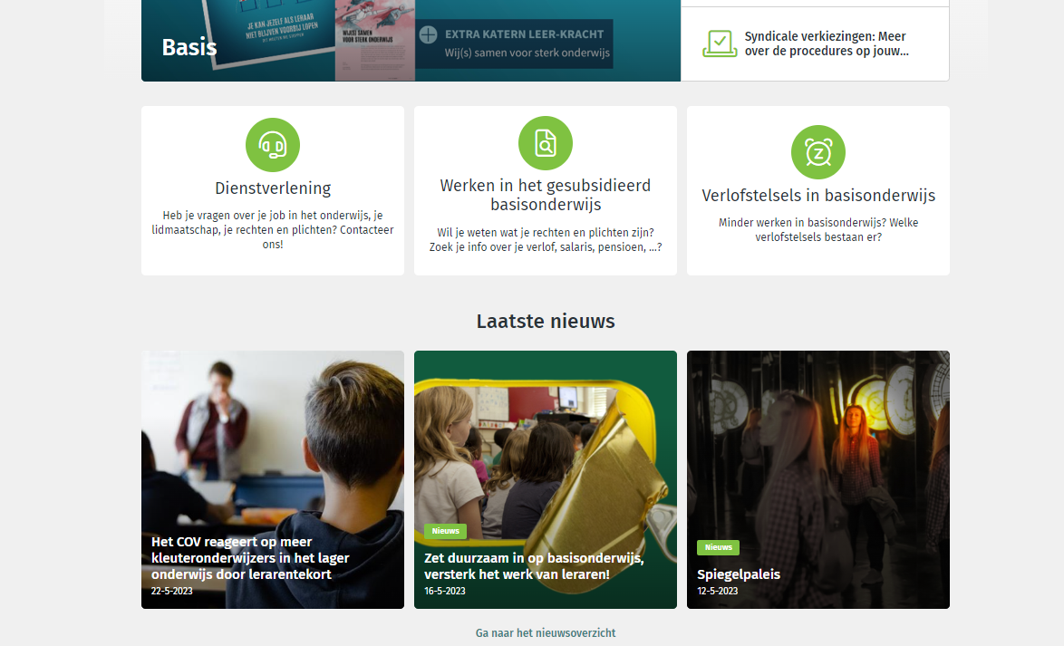
COV-website
News items

Slide 39
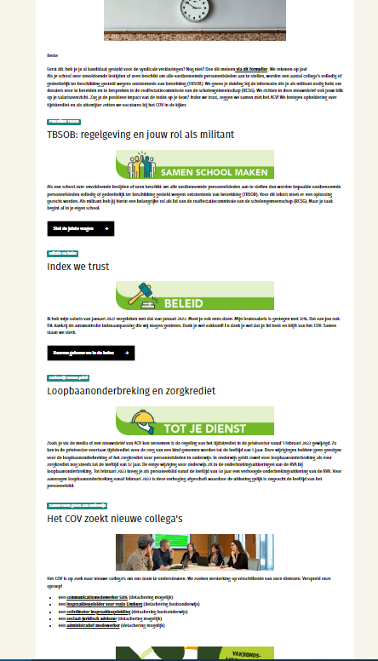
Newsletters
10 per year to representatives of the personnel and schoolleaders
“Hot off the needle” to all members
Select the addressees
Needs to be re-evaluated

Slide 40
Webinars
Digital trainings
Various topics
Webinar Geek
Members and non-members

Slide 41
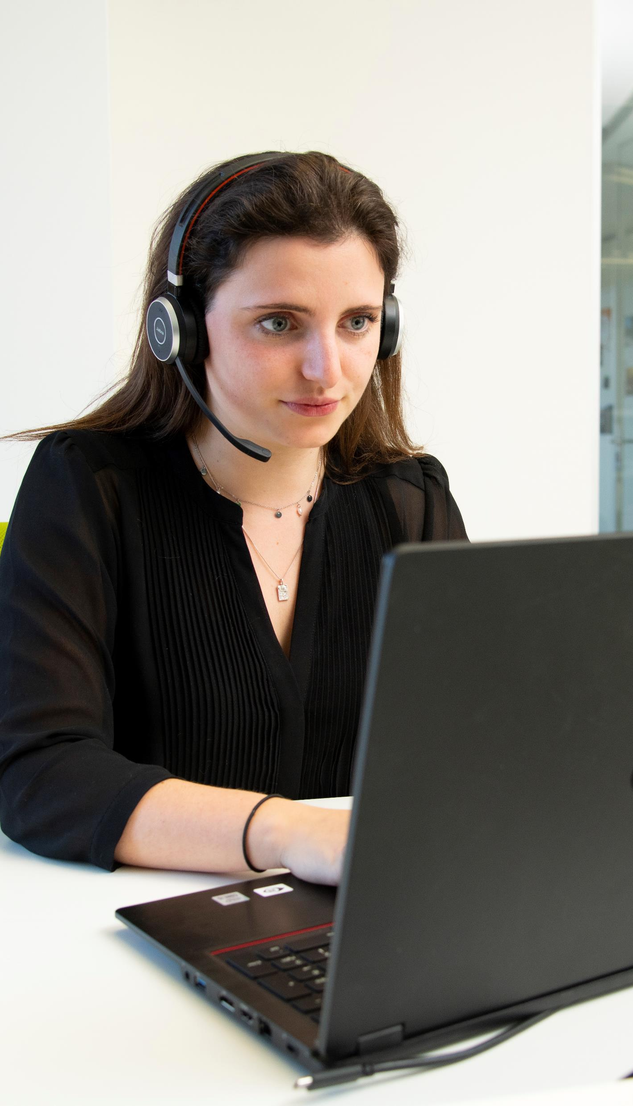
Member services
Digital appointments
Teams
Centralizing the incoming mails
Transparant and central call center

Slide 42


Questions?
Thank you for your attention!

