Slide 1
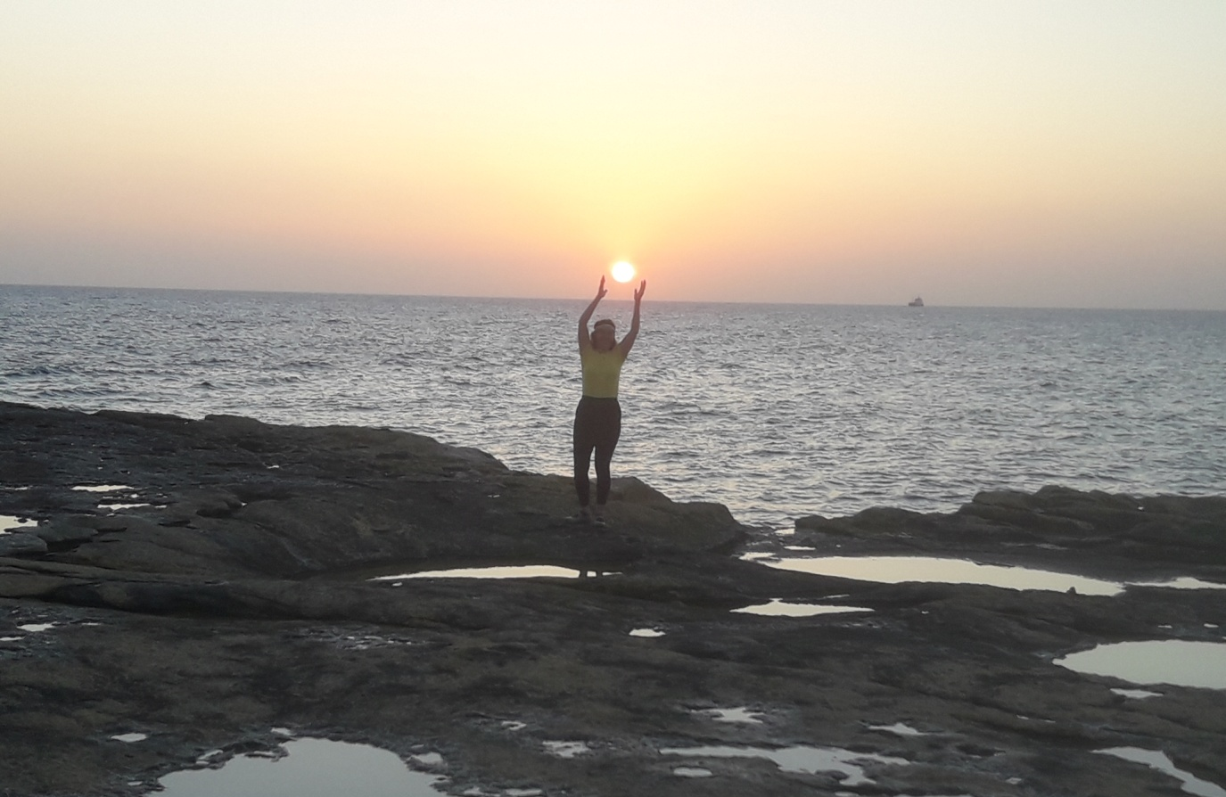
How bringing married couples together helps build strong families and good citizens who uphold fundamental human values in society, in the nation, and inEurope, even in the third millennium

Slide 2
NAJINA POT (naša cesta)
Jesuit work
-helps couples build stronger marriages and families
•Community of married couples (monthly meetings (since 1972))
*Spiritual retreats (once a year, since 1968)
*Marriage preparation courses, year-round preparation for marriage
*Student group
*Annual meeting of married couples
*Newsletter NAJINA POT

Slide 3
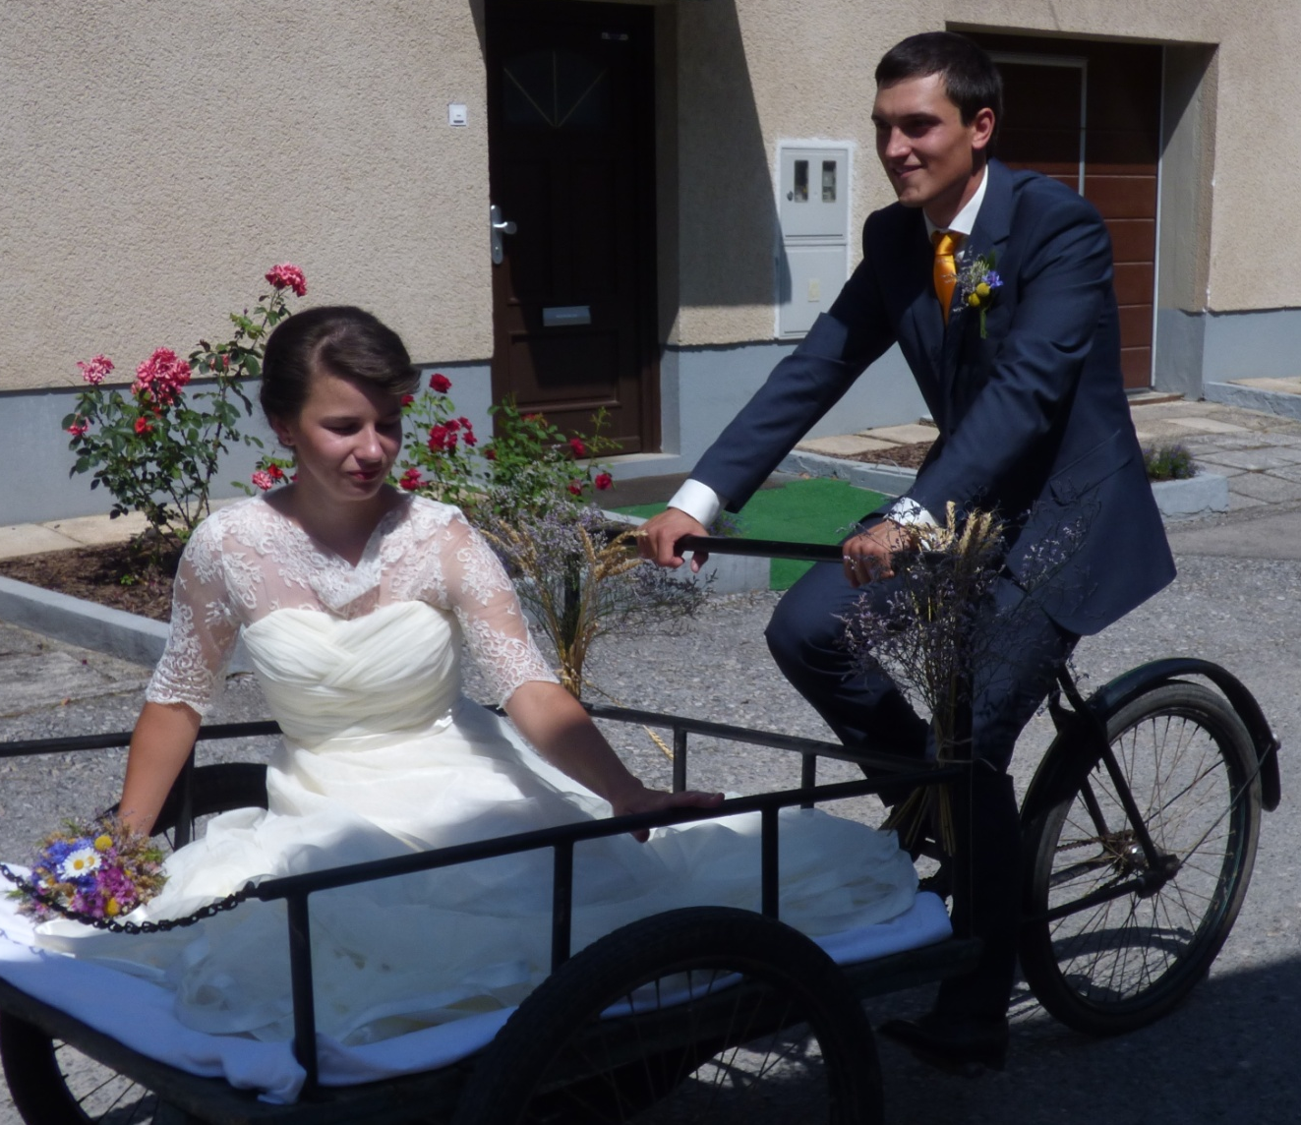
Following couples, from youthful love to the transition into eternity

Slide 4
Marriage Preparation Classes for Future Married Couples
  •In-depth and serious, long-term preparation of couples for marriage, a lifelong union, and commitment
  •Couples discuss various aspects of married life
  •Group dynamics are taken into account
  •Each couple actively participates, building a solid foundation
  •They share their perspectives and experiences in depth on a topic they have previously agreed upon
  •They meet regularly twice a month throughout the year

Slide 5
Marriage Preparation Classes for Future Married Couples
•work on themselves
•respectfully share their experiences,
•grow increasingly close,
•become friends with one another and, after completing the marriage preparation program, join a follow-up marriage couples group.

Slide 6
SPIRITUAL EXERCISES
The Beginnings
In 1968, the Jesuit Father Vital held the first married couples’ retreat at St. Trinity in Slovenske Gorice. Father Vital wrote:“The atmosphere was excellent. May God grant that this continue year after year.”Preserved record of registration for the retreat.

Slide 7
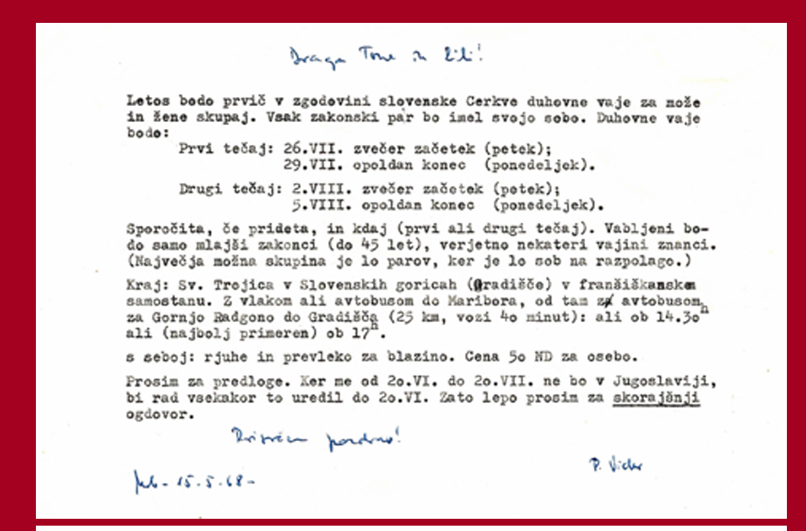
DUHOVNE VAJE-duchovné cvičenia pre manželov
First announcement of the spiritual exercises for married couples in 1968
.

Slide 8
DUHOVNE VAJE - SPIRITUAL EXERCISES
Three days of peace and silence
for reflecting on marital and family life
.

Slide 9
DUHOVNE VAJE - SPIRITUAL EXERCISES
Spiritual exercise takes place year-round on weekends
•Childcare is provided
•Three days of peace of mind to reflect on married and family life
•In silence, in the evenings, couples share their experiences
•Married couples hear and see other couples and other parents, thereby enriching their own lives
•They can help other couples with their own experiences
.

Slide 10
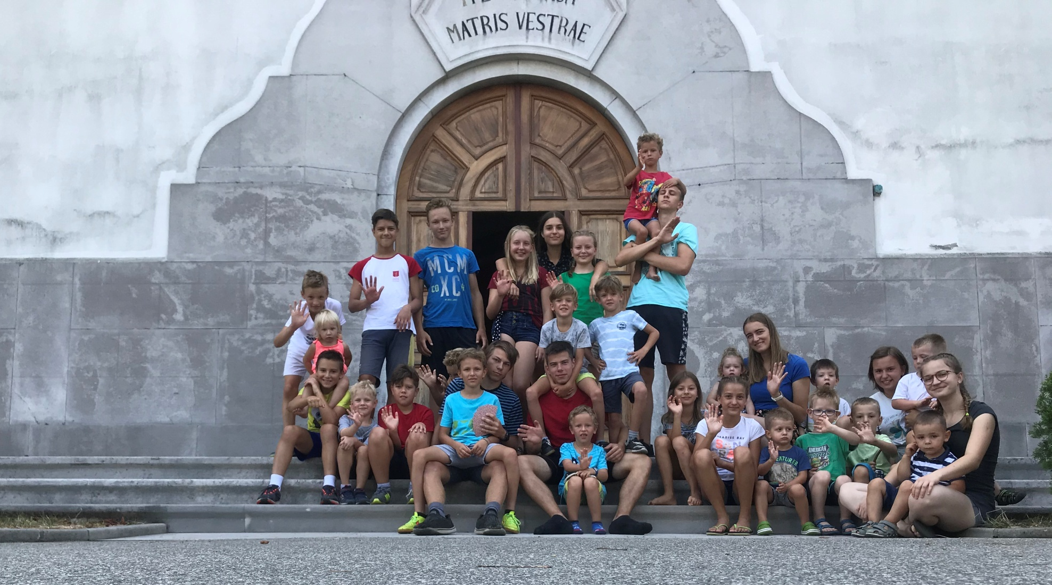
DUHOVNE VAJE SPIRITUAL EXERCISES
Childcare is provided

Slide 11
MARRIAGE GROUPS
The first marriage group was formed in 1972 during a spiritual exercise for married couples
• Couples who wish to preserve and nurture their marriage meet and build friendships.
•The primary goal is to help the couple become the best married couple they can be,
• so that both partners can grow and learn to live the way they have always wanted and desired.

Slide 12
How Marriage Groups Work ?
The group consists of seven to ten married couples.
•Meetings are held once a month at the home of one of the couples.
•The group always consists of the same couples.
•Discussions within the marriage group are personal and remain within the group.
*Married couples form close friendships..

Slide 13
Married couples' groups hold monthly meetings
for a stronger marriage,
•for more successful parenting,
•for a more meaningful role in society
•for more active involvement in the parish
•for a more stable marriage
•serve as a preventive measure

Slide 14
Encounters and friendships between couples - The evening goes like this
PART 1: Reflections on the Gospel
PART 2: A Topic from Married Life
PART 3: Social Life

Slide 15
Part 1
PART 1: Reflections on the Gospel
is dedicated to reflecting on a passage from the Gospel.
• Couples choose the passage at the previous meeting.
• Between meetings, the couple reflects, discusses, and tries to answer the question: What does God’s Word mean for them as husband and wife, father and mother?
• At the meeting, each person shares a thought that they believe will be of interest to others.

Slide 16
PART 2: A Topic from Married Life
The second part of the evening is devoted to topics related to married or family life.
• Each individual or couple shares what they have discovered during their preparation for the meeting to be their own experience.
• The discussion in the marriage group follows the principles of group dynamics
• It is not a debate club where couples try to convince each other of something and interrupt one another.
• It is not an educational school; it is an exchange of marital or family experiences.

Slide 17
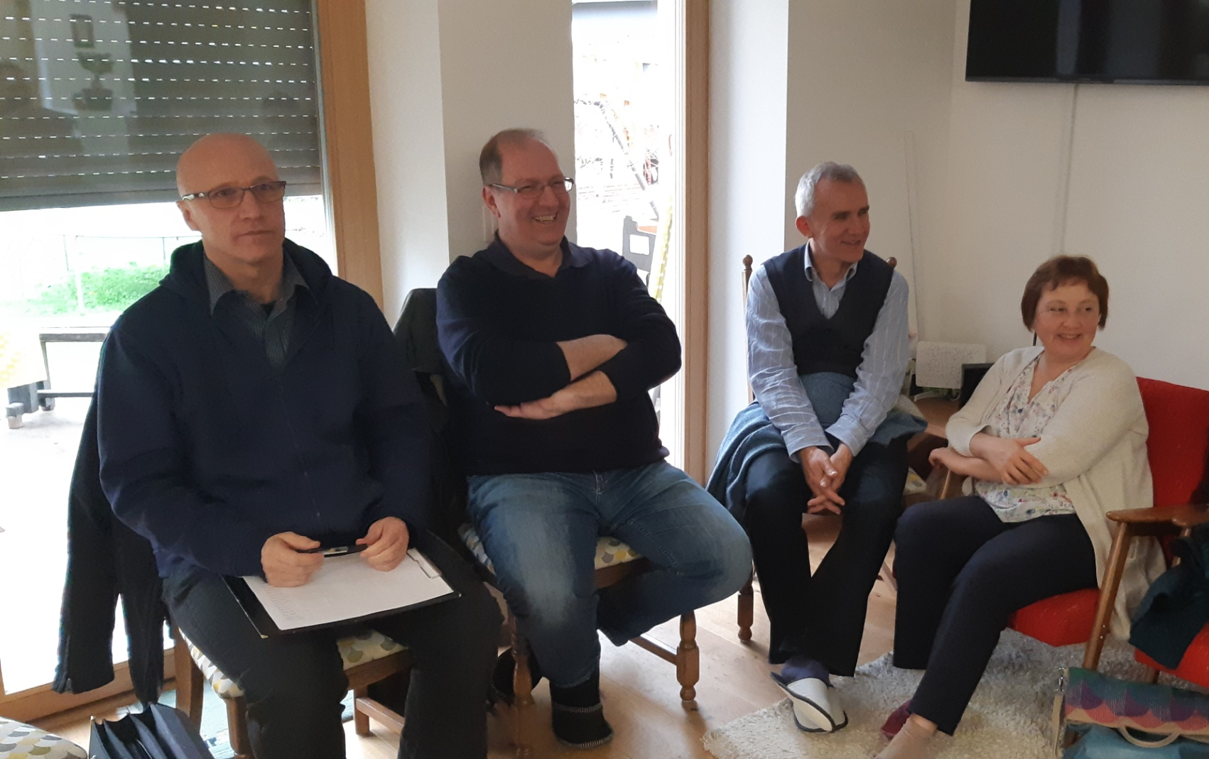
The third part is optional and is intended for socializing.
Part 3: Social life

Slide 18
History and Statistics
Since 1972—that is, for 54 years since “Najina pot” was founded—a new married couples’ group has been established on average every year.
• Today, there are 65 “Najina pot” married couples’ groups throughout Slovenia,
• comprising 440 married couples,
• approximately 1,390 children, though the number of young people is still changing.
• In our 11th group, the average is 5.12 children per married couple
• married couples’ groups operate from Radgona to Prevalje, from Tolmin to Kočevje, from Novo Mesto to Ankaran.
• Forty couples from older married groups lead the Marriage preparation classes. The preparations are held in 7 cities in Slovenia: in Ljubljana, Maribor, Cerknica, Kranj, Vrhnika, Nova Gorica, and Dob pri Domžalah.

Slide 19
Encounters and friendships between couples
The group consists of seven to ten married couples.
They meet once a month at the home of one of the couples.
The group is always made up of the same couples.
Discussions in the marriage group reveal personal matters and the couples develop a close bond.
Friendship among the couples grows slowly.

Slide 20
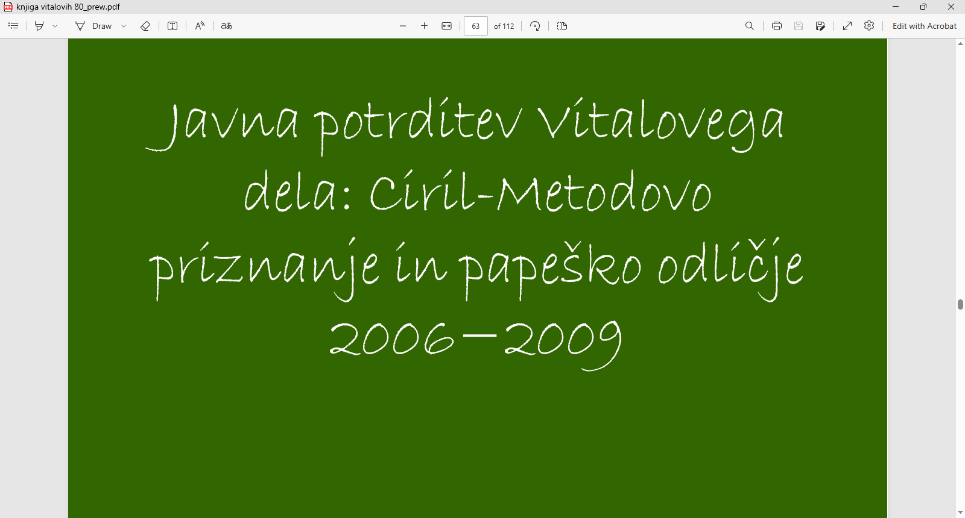
Awards
The NAJINA POT movement has received the following two awards through the Jesuit Vital, the founder of the NAJINA POT movement :

Slide 21
STUDENT GROUP “ZORENJE”
Student Group - The group consists of students
Meetings are held once a week, every Thursday evening, at the St. Joseph Center in Ljubljana
The group consists of the same members throughout the entire academic year
Discussions in the group follow group dynamics: one person speaks while the others listen
The students form close friendships. Each year they conclude with a group outing and a visit to a student spiritual retreat

Slide 22
ANNUAL MEETING OF THE "NAJINA POT" MARRIED COUPLES' GROUPS
Every year, all the NAJNA POT marriage groups gather for a joint Mass to pray together for strong marriages. The gathering is followed by a social gathering where couples have the opportunity to get to know one another.

Slide 23
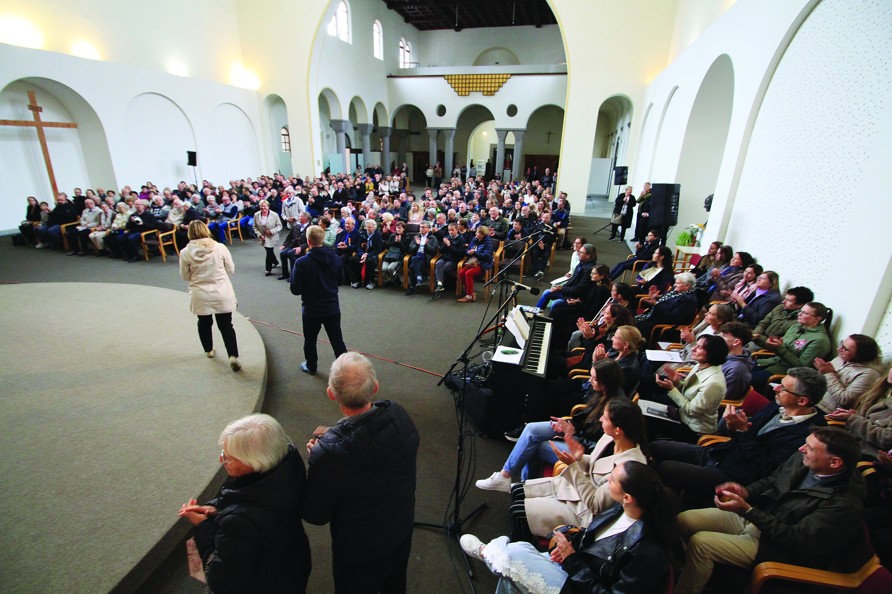

Slide 24
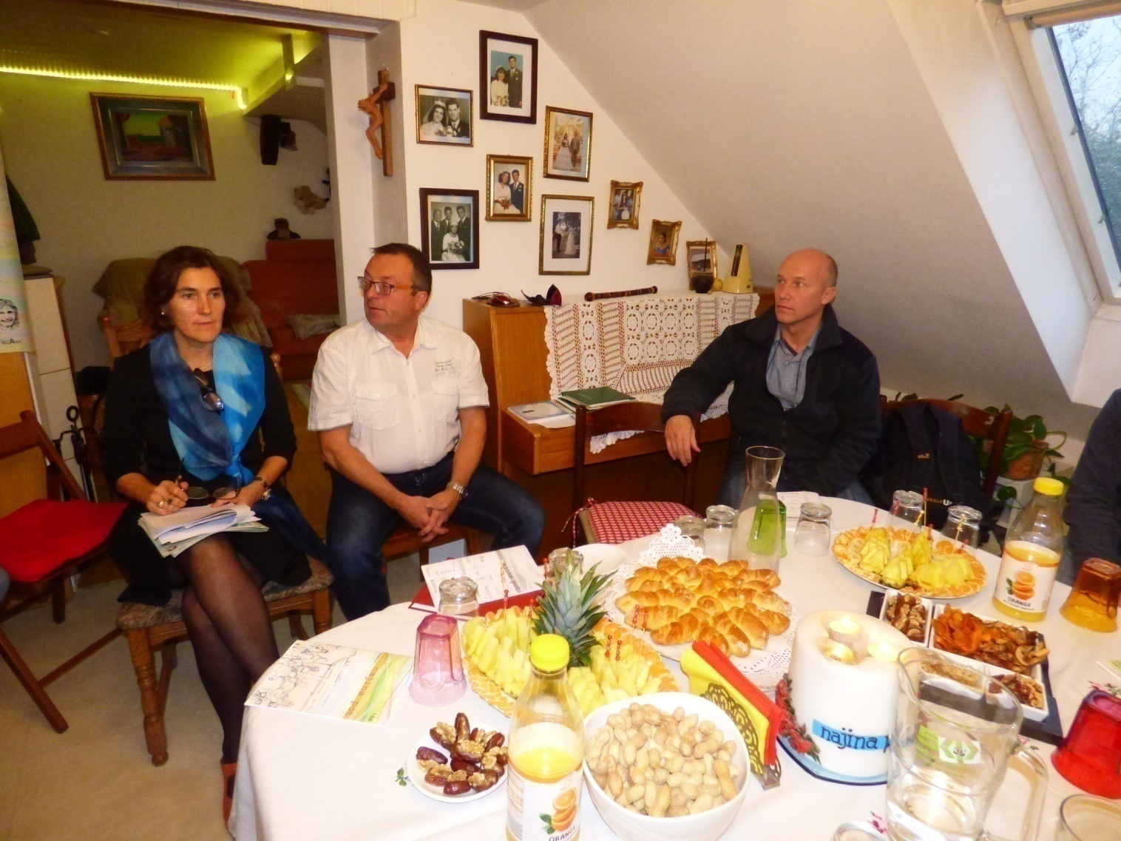
The "Najina pot" Newsletter since 1990
.
.

Slide 25
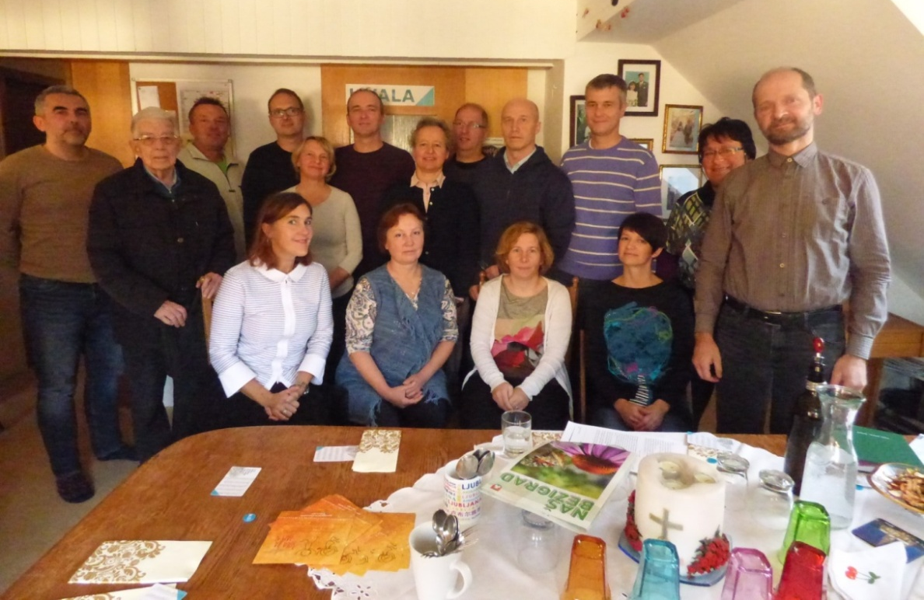
Published 6 times a year
Connects and informs married couples
It publishes only personal testimonies and serves as a spiritual source of encouragement from Jesuit priests
Editorial Board

Slide 26
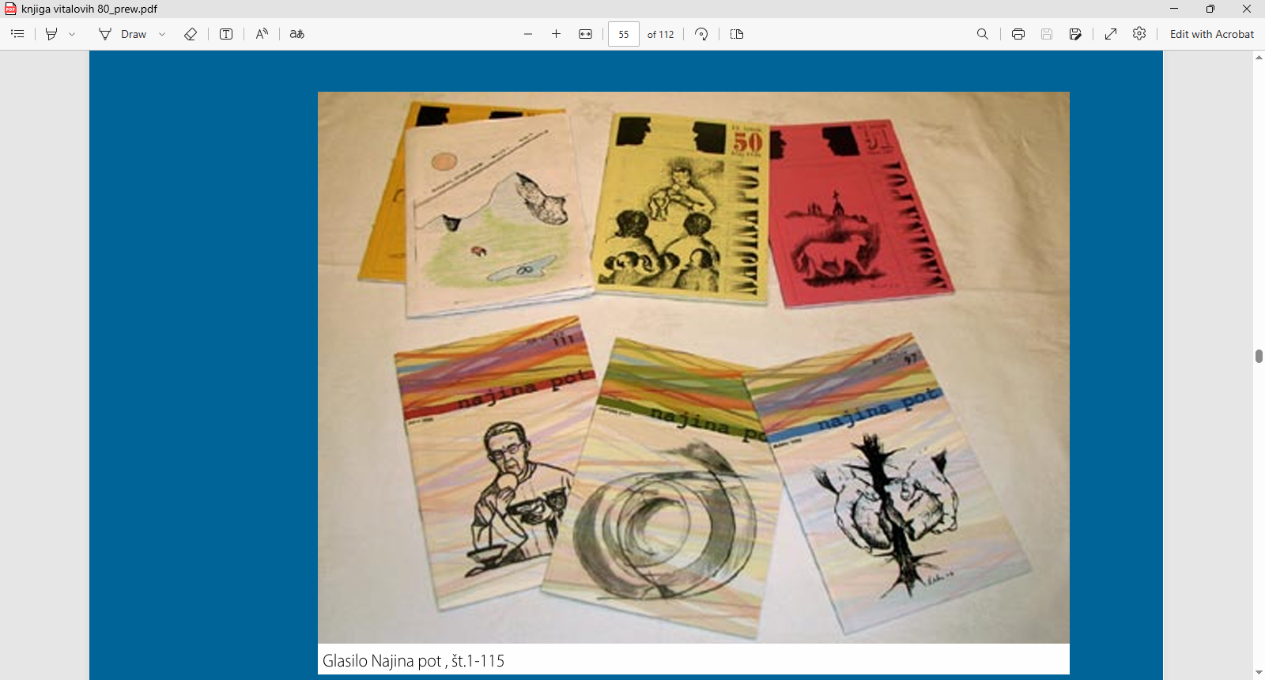
214 issues of the newsletter
Duhovne vaje potekajo čez vse leto
ob koncih tedna
izmenjava izkušenj ob večerih.
Za varstvo otrok je poskrbljeno
tri dni miru za pregled zakonskega in družinskega življenja
slišita in vidita druge zakonce, starše in se tako bogatita
pomagata drugim s svojimi izkušnjami
.
.

Slide 27
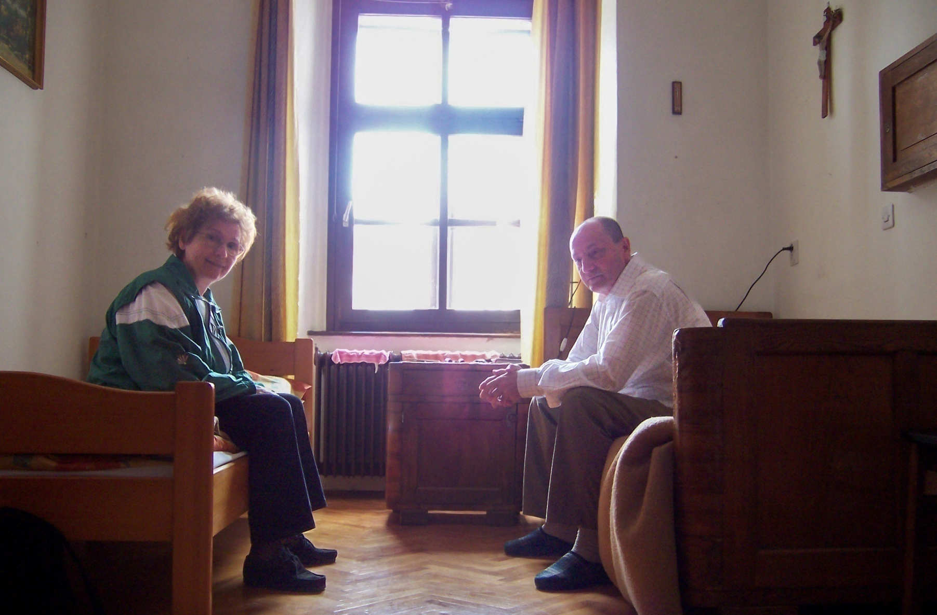
Marriage spiritual exercises at Stična Monastery

Slide 28
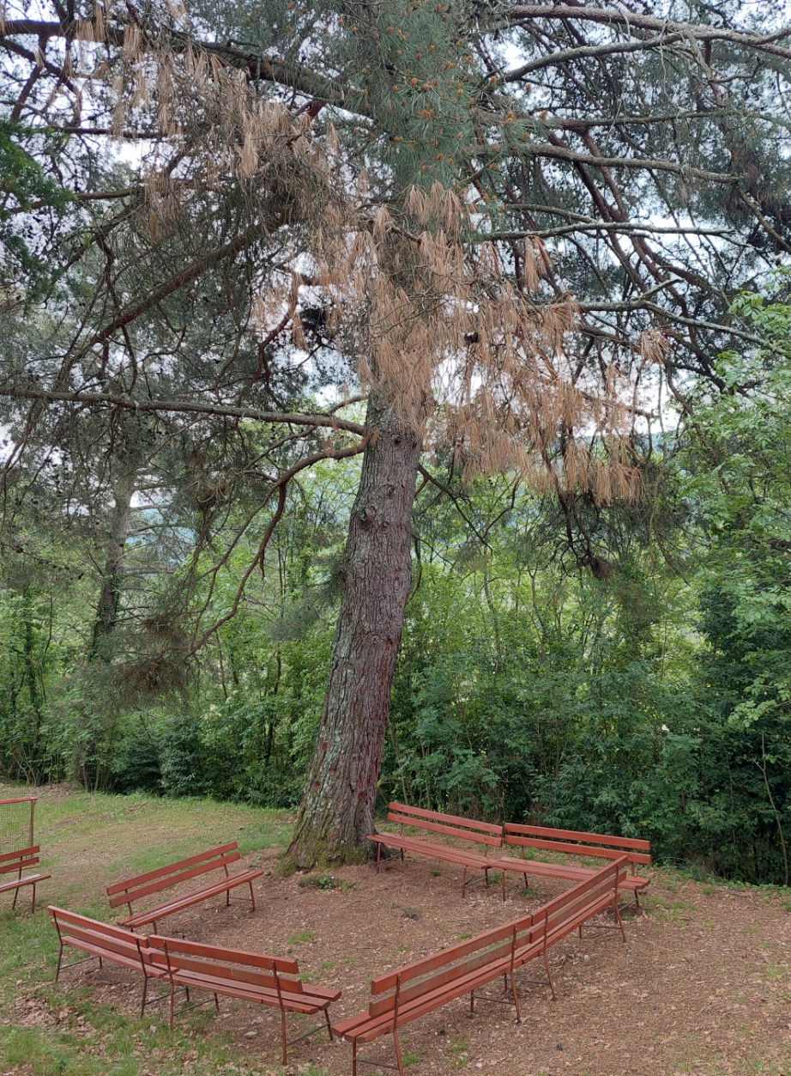
Marriage retreat for couples at Miren Castle,this pine tree is over 300 years old

Slide 29
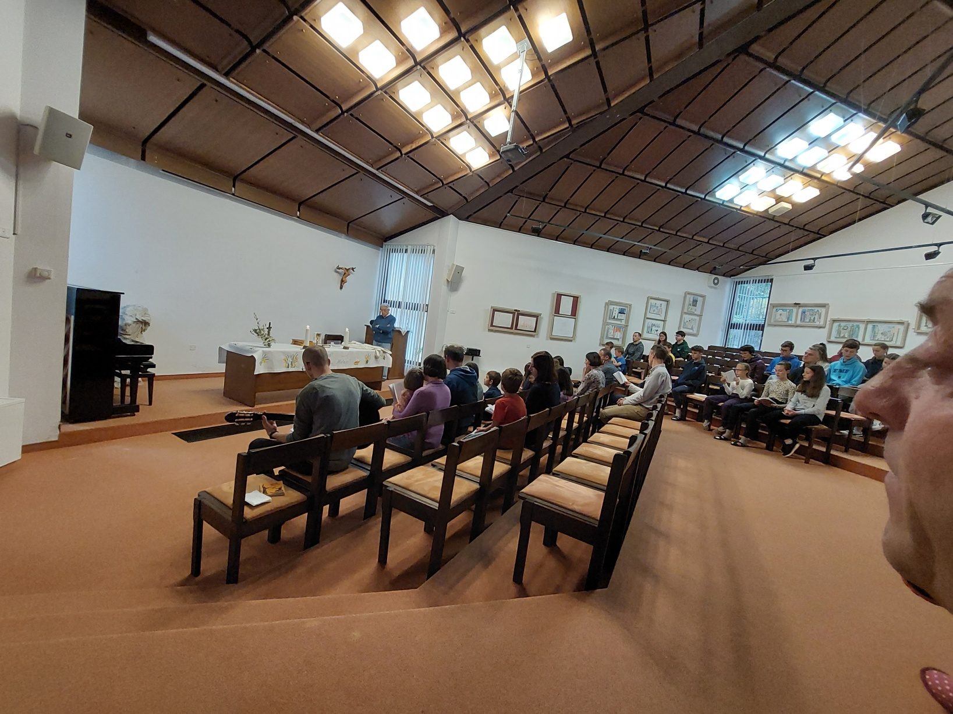
Marriage spiritual exercises at Miren Castle – Evening Mass

Slide 30
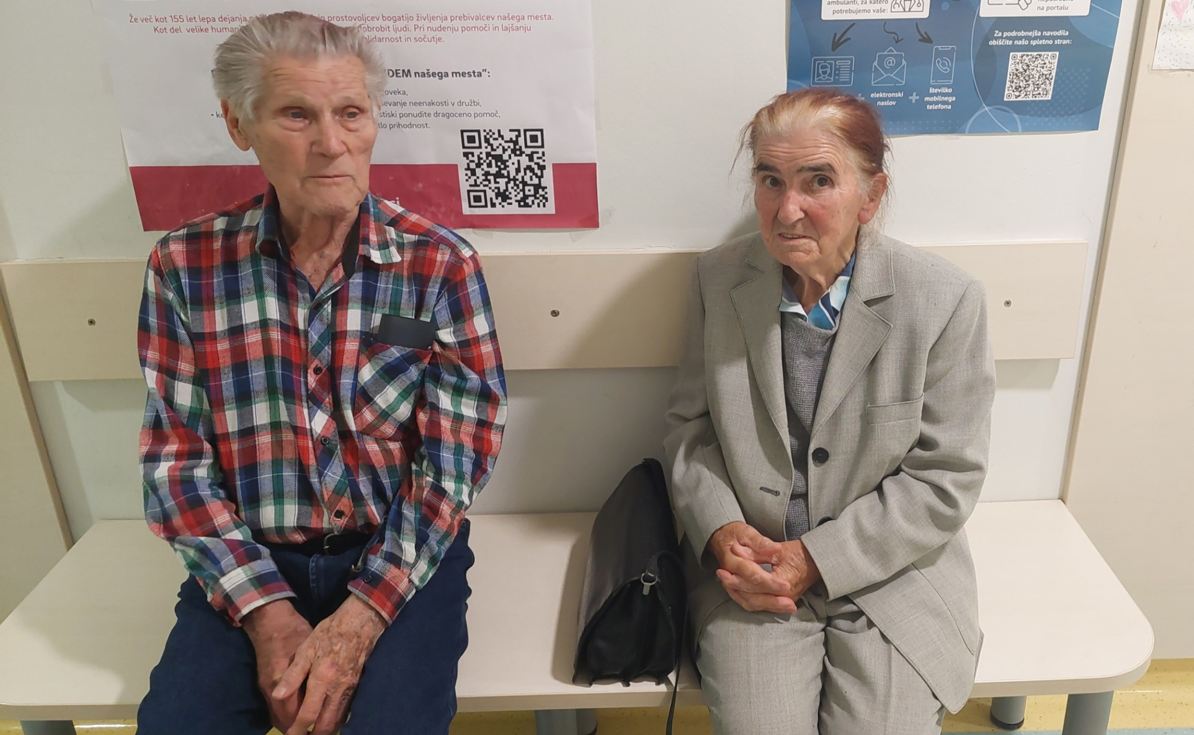
Couples who have lived to be over 90 years old and have been married for more than 60 years

Slide 31
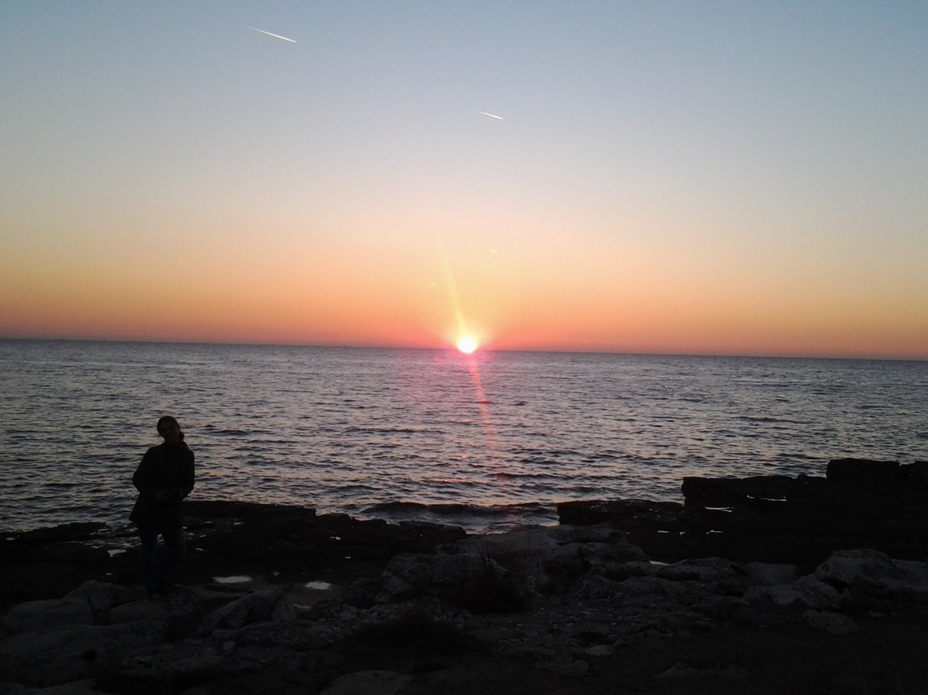
In this way, the Church in Slovenia continues to accompany both those in love and those who are married, even in the third millennium
Notes:
nnnnnnnnnnnnnnnnnnnnnnnnnnnnnnnnnnnnnnnnnnnnnnnnnnnnnnnnnnnnnnnnnnnnnnnnnnnn

Slide 32
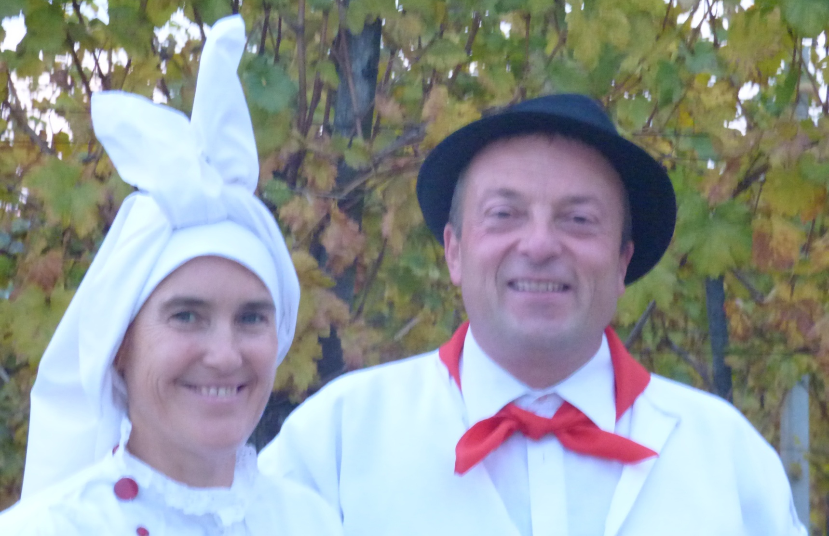
Ďakujeme za pozornosť
Boris a Karolina

